Slide 1
Parkinson's Disease Progression Prediction
Ran Minerbi

Slide 2
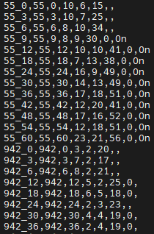
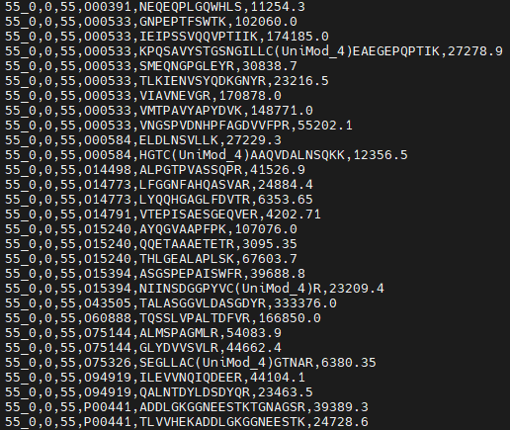
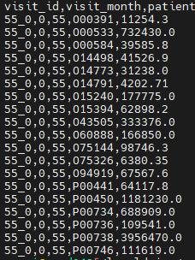
input data
Raw medical data from Kaggle
Patient_id , visit_mounth , raw medical data
Train clinical data train peptides train proteins

Slide 3
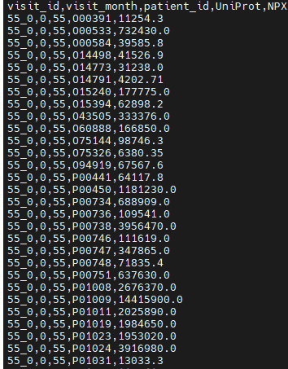
Protein input
Protein input file
232,742 lines of data
1113 visits of 248 patients
227 proteins and corresponding values

Slide 4
Peptides Data
Peptide input file
1113 visits of 248 patients
227 different types of proteins and 968 different peptides within abundance per each

Slide 5
Clinical data
Clinical data input file
2615 visits of 248 patients
Updrs[1-4] – Unified Parkinson's Disease Rating Scale clinical assessment for
Mentation, Behavior, and Mood - cognitive impairments
Activities of Daily Living (ADL) - Evaluates the patient's ability to perform everyday tasks
Motor - comprehensive assessment of motor function
Complications of Therapy - complications arising from medication
Clinical state on medication

Slide 6
Our task
Predict updrs[1-4] clinical assesment after 4 years from first diagnose (mounth 48)
based on patient medial history raw data
Data constraints
Many missing parameters or updrs clinical assessments
we have blood samples (protein/peptide) data for ~50% of visits
Updrs assessments provided by neurologists – may not be precise values

Slide 7
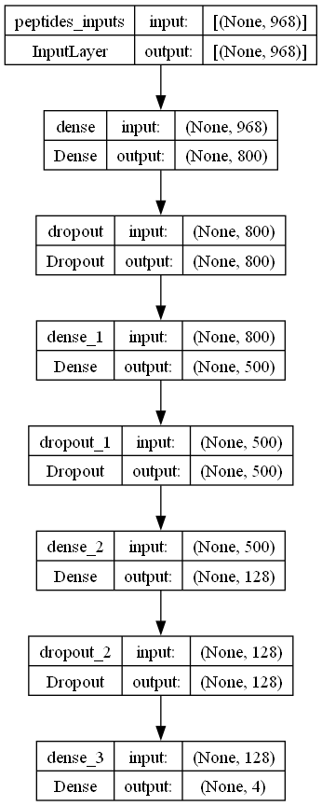
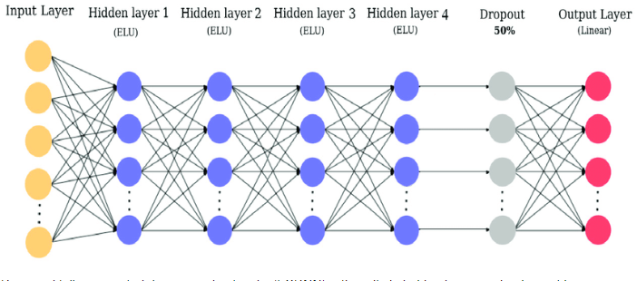
Approach 1
Predict updrs[1-4] for month 48 by peptide input data within fully connected neural network

Slide 8
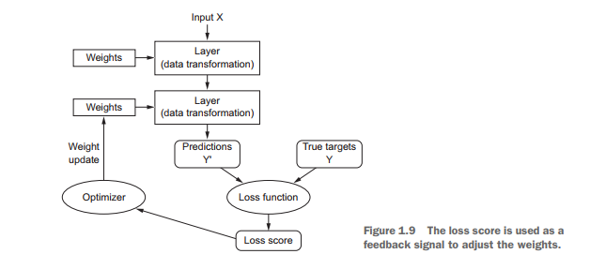
Training loss outline procedure
Loss should be minimized during training

Slide 9
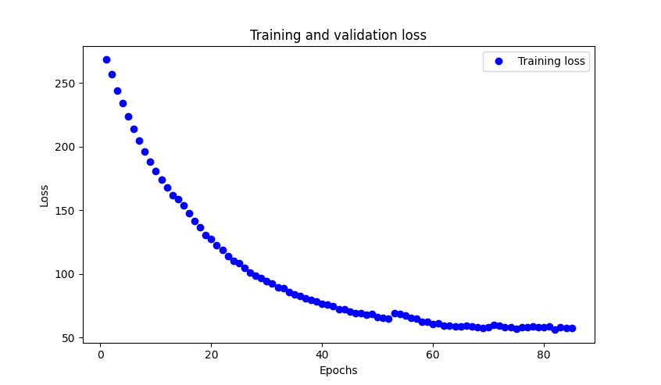
Training loss
Fit coverage failed - why ?

Slide 10
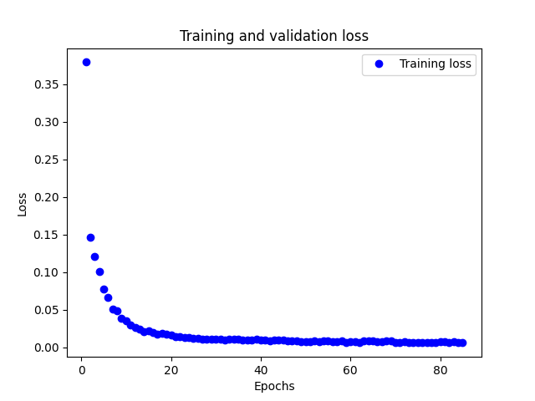
Training loss within data normalization
Data is much more important than algorithm in use

Slide 11
Overfit
Optimization refers to the process of adjusting a model to get the best performance possible on the training data, whereas generalization refers to how well the trained model performs on data it has never seen before
Learning how to deal with overfitting is essential to mastering machine learning
Avoid overfitting :
Get more training data
Reduce network capacity
Add weight regularization
Add dropouts

Slide 12
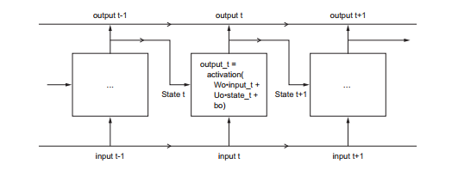
Long Short-Term Memory (LSTM) Network

Slide 13
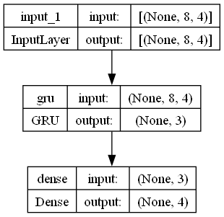
Approach 2
Predict updrs[1-4] for month 48 by previous updrs assessments using GRU network

Slide 14
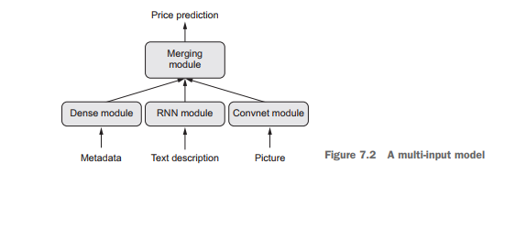
Keras Functional API
Merge layers originated by different architectures into single output prediction

Slide 15
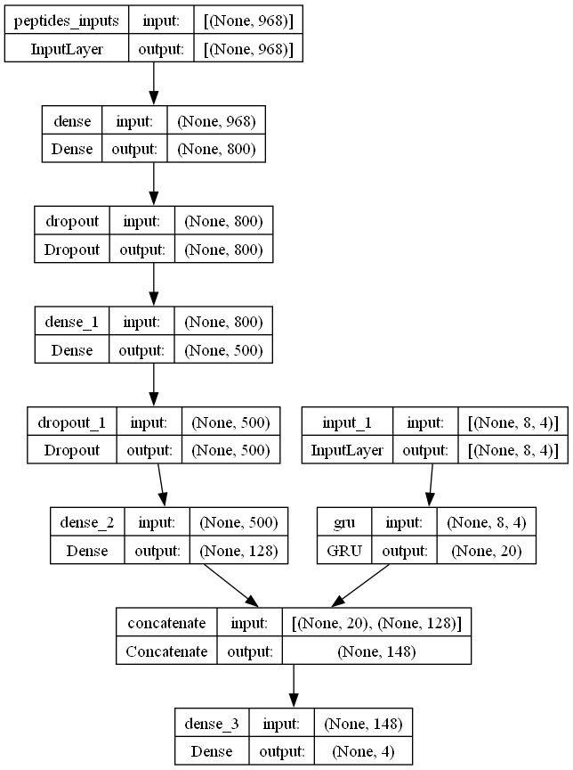
Approach 3
Path 1
Path 2
Keras Functional API
Path 1
Predict updrs for V_48 by peptide vector
Path 2
Predict updrs for V_48 by previous updrs diagnostics (V_0, V_6, V_18, V_24, V36)
Merge layers and predict updrs for V_48

Slide 16
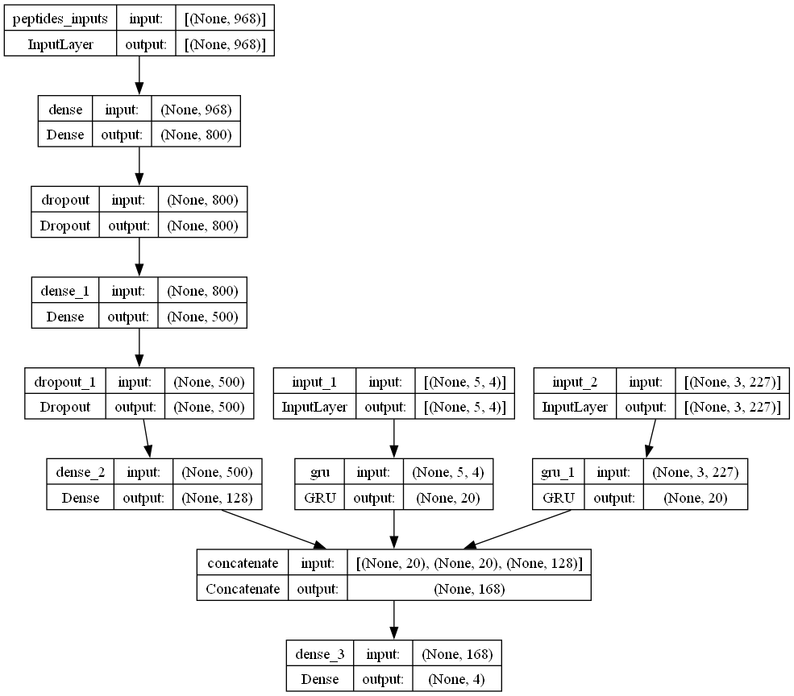
Approach 4
Path 1
Path 2
Path 3
Path 1
Predict updrs for V_48 by peptide vector
Path 2
Predict updrs for V_48 by previous updrs diagnostics (V_0, V_6, V_18, V_24, V36)
Path 3
Predict updrs for V_48 by protein blood samples from
(V_0, V_18, V_36)
Merge layers and predict updrs for V_48

